Slide 1
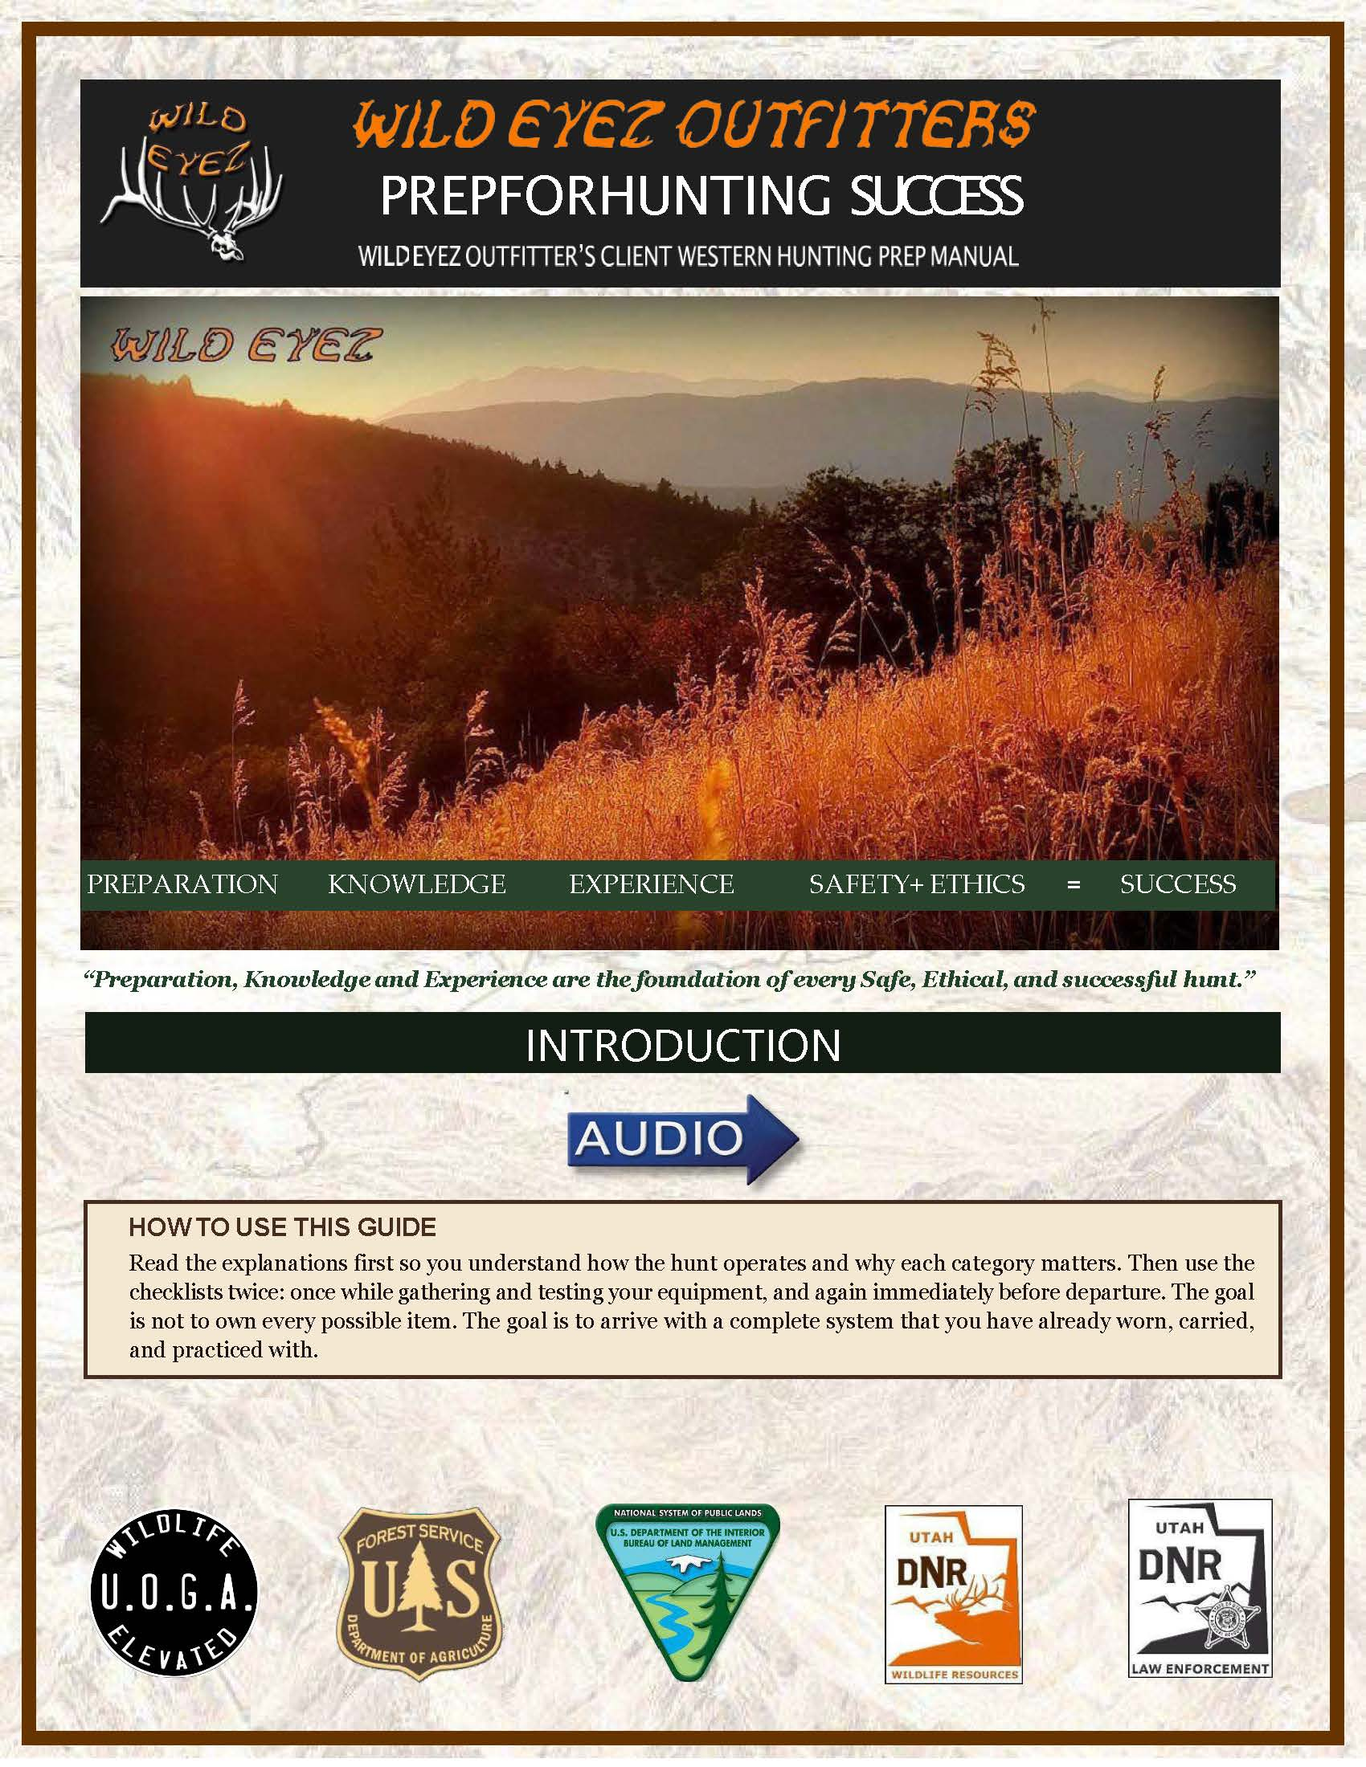
Page 1 - INTRODUCTION AND HOW TO USE THIS GUIDE Presenter direction: Open on the full first page. Let the title and Wild Eyez identity settle on screen. Then move gently toward the opening quote and the How to Use This Guide box. Spoken presentation: Page 1 introduces the purpose of this packet. This is not just a packing list. It is a preparation guide built around safety, field readiness, and the kind of practical experience that matters when the mountain finally gives you a chance. The opening statement sets the tone: "Preparation, knowledge, and experience are the foundation of every safe, ethical, and successful hunt." Now highlight the How to Use This Guide box. This box matters because it tells the client how the packet is meant to be used. The explanations come first so the hunter understands why each category matters. Then the checklists should be used twice: once while gathering and testing equipment, and again right before departure. The goal is not to own every possible item. The goal is to arrive with a complete system that has already been worn, carried, tested, and practiced with.
Notes:
PAGE 1 - INTRODUCTION AND HOW TO USE THIS GUIDE Presenter direction: Open on the full first page. Let the title and Wild Eyez identity settle on screen. Then move gently toward the opening quote and the How to Use This Guide box. Spoken presentation: Page 1 introduces the purpose of this packet. This is not just a packing list. It is a preparation guide built around safety, field readiness, and the kind of practical experience that matters when the mountain finally gives you a chance. The opening statement sets the tone: "Preparation, knowledge, and experience are the foundation of every safe, ethical, and successful hunt." Now highlight the How to Use This Guide box. This box matters because it tells the client how the packet is meant to be used. The explanations come first so the hunter understands why each category matters. Then the checklists should be used twice: once while gathering and testing equipment, and again right before departure. The goal is not to own every possible item. The goal is to arrive with a complete system that has already been worn, carried, tested, and practiced with.
[Sources]
Wild Eyez Outfitters current packet page image and Adobe presentation script.

Slide 2
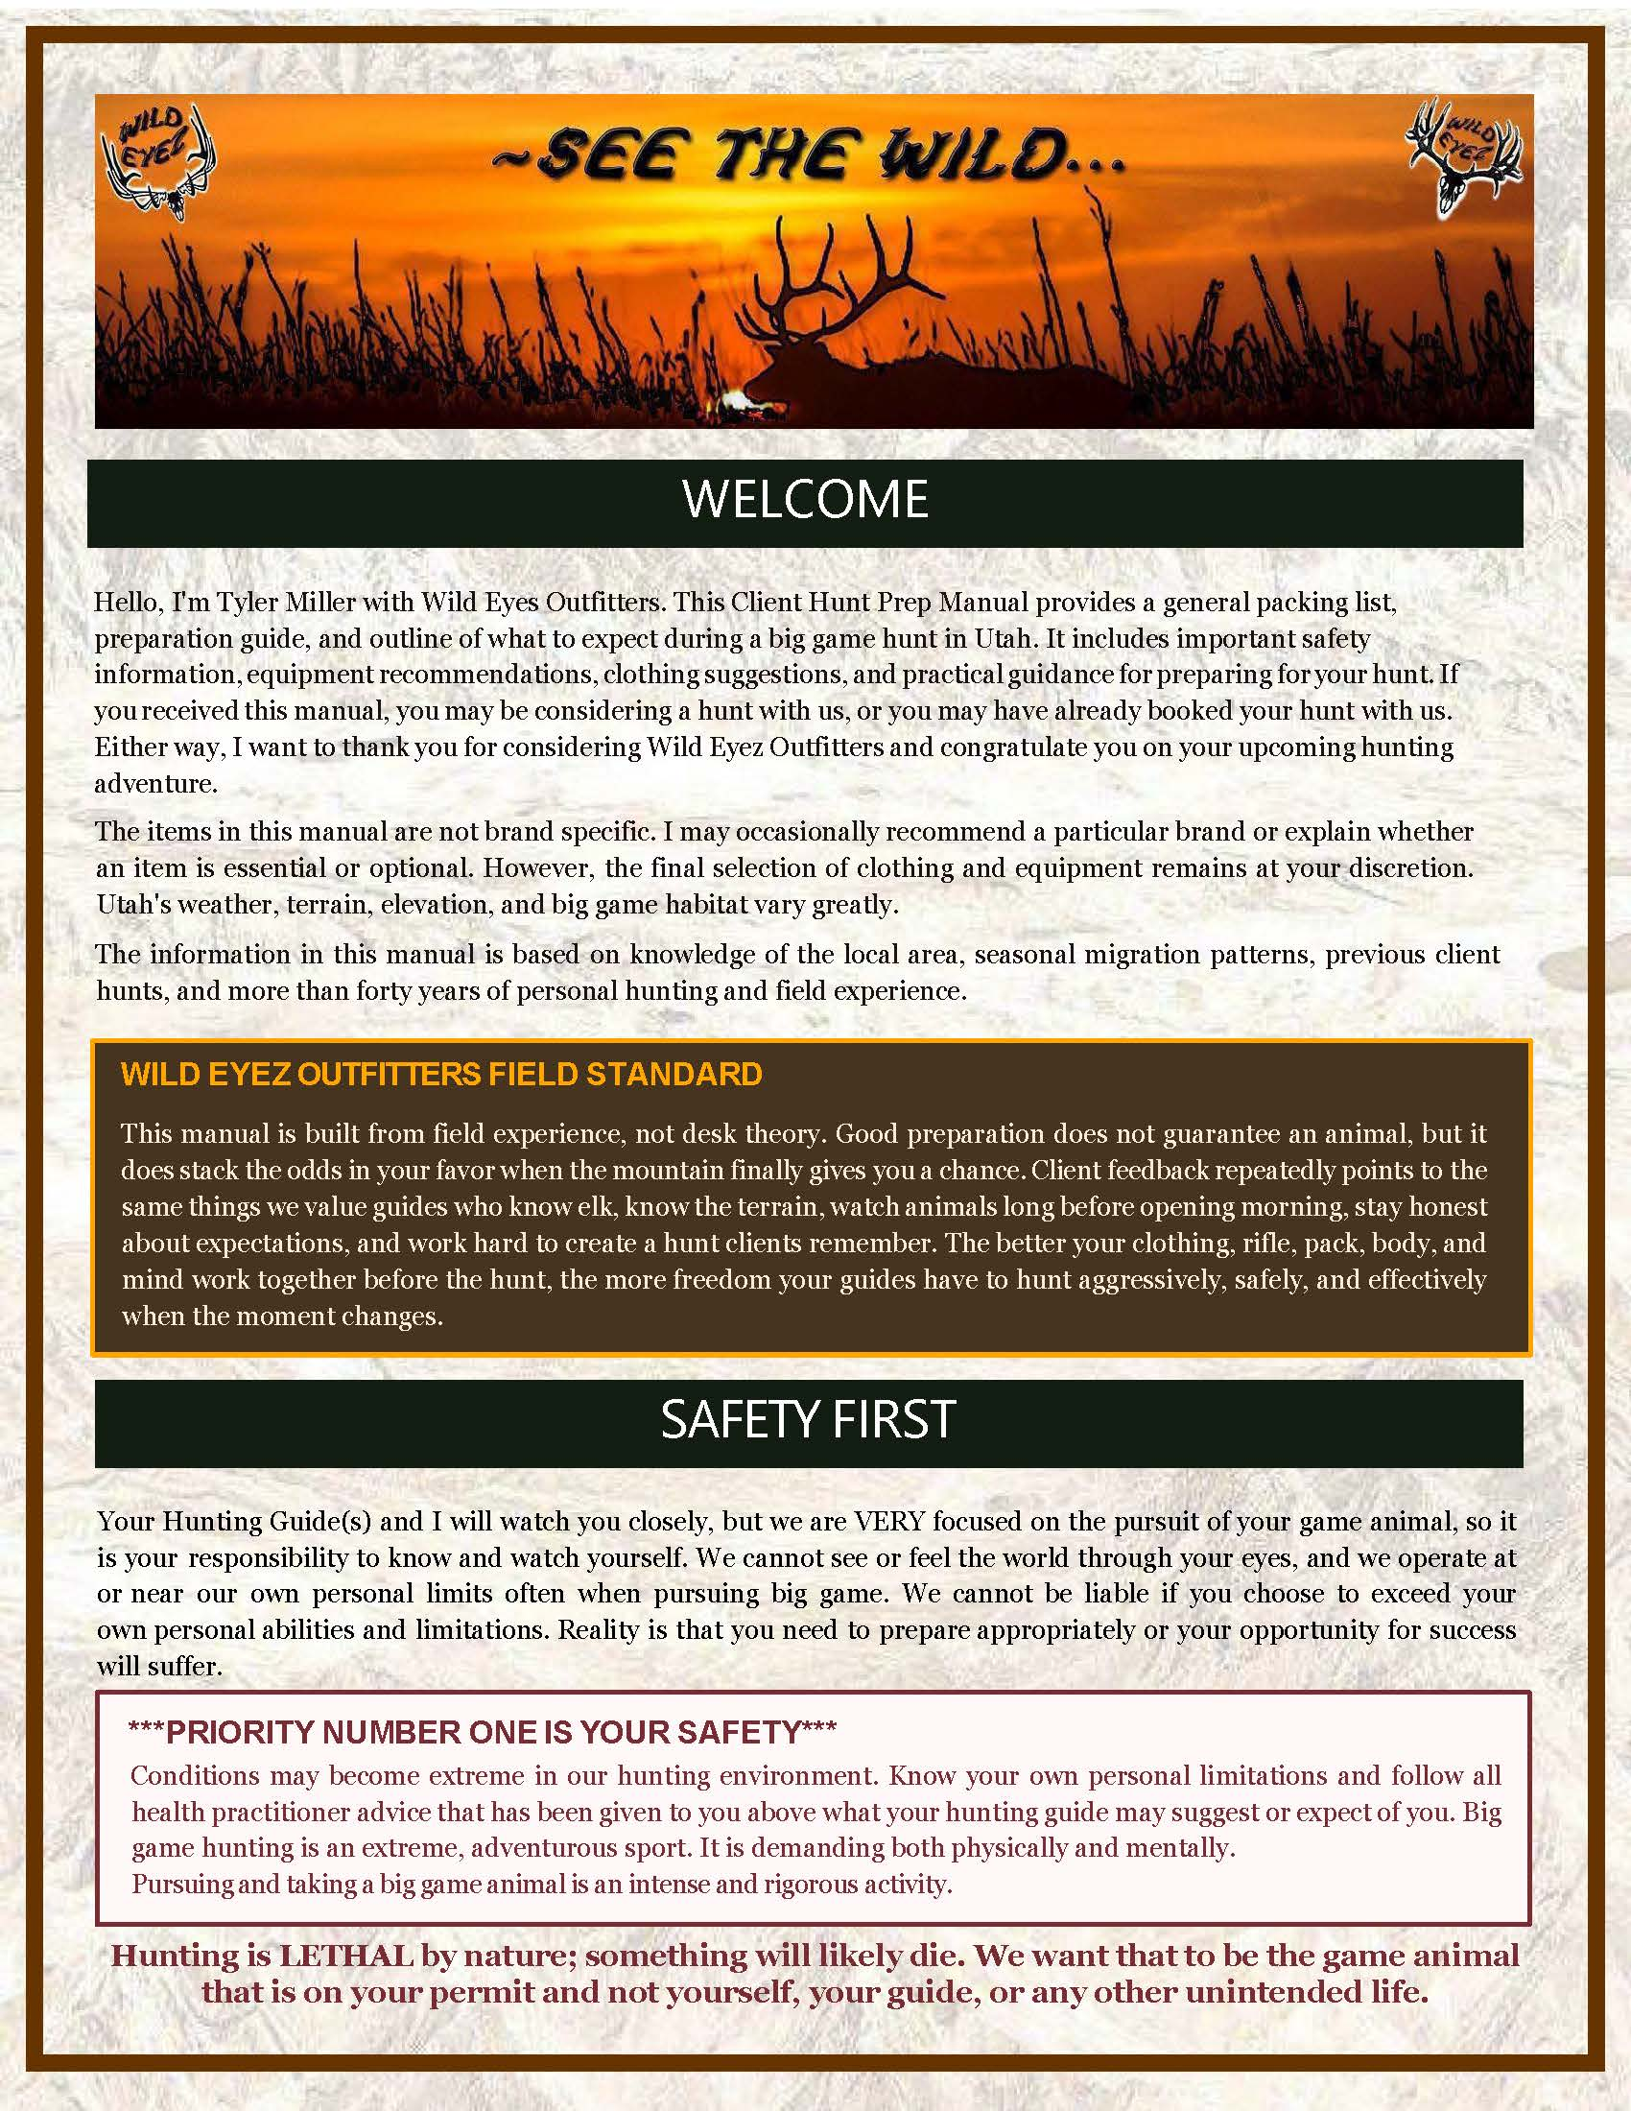
Page 2 - WELCOME, FIELD STANDARD, AND SAFETY FIRST Presenter direction: Show Page 2 as a full page first. Then move through the welcome paragraph, the Wild Eyez Field Standard box, and finally the Safety First section. Spoken presentation: Page 2 begins with the welcome. Hello, I am Tyler Miller with Wild Eyez Outfitters. This Client Hunt Prep Manual provides a general packing list, preparation guide, and outline of what to expect during a big game hunt in Utah. It includes important safety information, equipment recommendations, clothing suggestions, and practical guidance for preparing for your hunt. If you received this manual, you may be considering a hunt with us, or you may have already booked your hunt with us. Either way, I want to thank you for considering Wild Eyez Outfitters and congratulate you on your upcoming hunting adventure. The items in this manual are not brand specific. I may occasionally recommend a particular brand or explain whether an item is essential or optional. However, the final selection of clothing and equipment remains at your discretion. Utah's weather, terrain, elevation, and big game habitat vary greatly. The information in this manual is based on knowledge of the local area, seasonal migration patterns, previous client hunts, and more than forty years of personal hunting and field experience. Now highlight the Wild Eyez Field Standard box. This box is important because it explains the difference between a generic packing list and a guide packet built from real field experience. This is not desk theory. Preparation does not guarantee an animal, but it does stack the odds in your favor. Client feedback repeatedly points to the same things we value: guides who know elk, know the terrain, watch animals long before opening morning, stay honest about expectations, and work hard to create a hunt clients remember. The better your clothing, rifle, pack, body, and mind work together before the hunt, the more freedom your guides have to hunt aggressively, safely, and effectively when the moment changes. Now move into Safety First. This is one of the most important sections in the packet. Your guide or guides and I will watch you closely, but we are very focused on the pursuit of your game animal. That means it is your responsibility to know and watch yourself. We cannot see or feel the world through your eyes, and we often operate at or near our own personal limits when pursuing big game. We cannot be liable if you choose to exceed your own personal abilities and limitations. Now highlight the Priority Number One Is Your Safety box. This alert box should stand out because it is not decoration. It is a serious safety standard. Conditions may become extreme in our hunting environment. Know your own personal limitations and follow all health practitioner advice that has been given to you above what your hunting guide may suggest or expect of you. Big-game hunting is an extreme, adventurous sport. It is demanding both physically and mentally. Pursuing and taking a big-game animal is an intense and rigorous activity. Hunting is lethal by nature. Something will likely die. We want that to be the game animal that is on your permit, and not yourself, your guide, or any other unintended life.
Notes:
PAGE 2 - WELCOME, FIELD STANDARD, AND SAFETY FIRST Presenter direction: Show Page 2 as a full page first. Then move through the welcome paragraph, the Wild Eyez Field Standard box, and finally the Safety First section. Spoken presentation: Page 2 begins with the welcome. Hello, I am Tyler Miller with Wild Eyez Outfitters. This Client Hunt Prep Manual provides a general packing list, preparation guide, and outline of what to expect during a big game hunt in Utah. It includes important safety information, equipment recommendations, clothing suggestions, and practical guidance for preparing for your hunt. If you received this manual, you may be considering a hunt with us, or you may have already booked your hunt with us. Either way, I want to thank you for considering Wild Eyez Outfitters and congratulate you on your upcoming hunting adventure. The items in this manual are not brand specific. I may occasionally recommend a particular brand or explain whether an item is essential or optional. However, the final selection of clothing and equipment remains at your discretion. Utah's weather, terrain, elevation, and big game habitat vary greatly. The information in this manual is based on knowledge of the local area, seasonal migration patterns, previous client hunts, and more than forty years of personal hunting and field experience. Now highlight the Wild Eyez Field Standard box. This box is important because it explains the difference between a generic packing list and a guide packet built from real field experience. This is not desk theory. Preparation does not guarantee an animal, but it does stack the odds in your favor. Client feedback repeatedly points to the same things we value: guides who know elk, know the terrain, watch animals long before opening morning, stay honest about expectations, and work hard to create a hunt clients remember. The better your clothing, rifle, pack, body, and mind work together before the hunt, the more freedom your guides have to hunt aggressively, safely, and effectively when the moment changes. Now move into Safety First. This is one of the most important sections in the packet. Your guide or guides and I will watch you closely, but we are very focused on the pursuit of your game animal. That means it is your responsibility to know and watch yourself. We cannot see or feel the world through your eyes, and we often operate at or near our own personal limits when pursuing big game. We cannot be liable if you choose to exceed your own personal abilities and limitations. Now highlight the Priority Number One Is Your Safety box. This alert box should stand out because it is not decoration. It is a serious safety standard. Conditions may become extreme in our hunting environment. Know your own personal limitations and follow all health practitioner advice that has been given to you above what your hunting guide may suggest or expect of you. Big-game hunting is an extreme, adventurous sport. It is demanding both physically and mentally. Pursuing and taking a big-game animal is an intense and rigorous activity. Hunting is lethal by nature. Something will likely die. We want that to be the game animal that is on your permit, and not yourself, your guide, or any other unintended life.
[Sources]
Wild Eyez Outfitters current packet page image and Adobe presentation script.

Slide 3
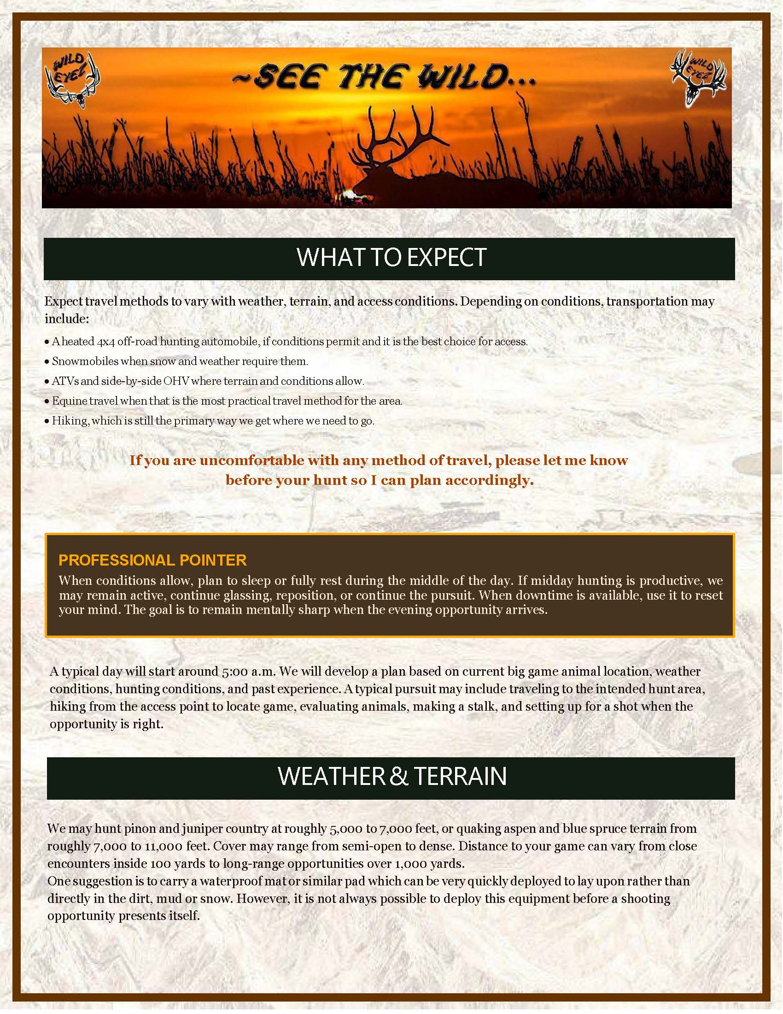
Page 3 - WHAT TO EXPECT, TRANSPORTATION, WEATHER, AND TERRAIN Presenter direction: Start with the page heading, then slowly move through the transportation list. Treat transportation as practical planning information. Then hold on the Professional Pointer box before moving into Weather and Terrain. Spoken presentation: Page 3 explains what to expect. Travel methods can vary with weather, terrain, and access conditions. Depending on conditions, transportation may include a heated 4x4 off-road hunting automobile, snowmobiles when snow and weather require them, A.T.V.s and side-by-side O.H.V.s where terrain and conditions allow, horse or mule travel when that is the most practical method for the area, and hiking, which is still the primary way we get where we need to go. If you are uncomfortable with any method of travel, please let me know before your hunt so I can plan accordingly. Now highlight the Professional Pointer box. This is guide insight. When conditions allow, plan to sleep or fully rest during the middle of the day. If midday hunting is productive, we may remain active, continue glassing, reposition, or continue the pursuit. But when downtime is available, use it to reset your mind. The goal is to remain mentally sharp when the evening opportunity arrives. That sounds simple, but in the field it can make a real difference. A typical day will start around 5:00 a.m. We will develop a plan based on current big game animal location, weather conditions, hunting conditions, and past experience. A typical pursuit may include traveling to the intended hunt area, hiking from the access point to locate game, evaluating animals, making a stalk, and setting up for a shot when the opportunity is right. Now move to Weather and Terrain. We may hunt pinion and juniper country at roughly 5,000 to 7,000 feet, or quaking aspen and blue spruce terrain from roughly 7,000 to 11,000 feet. Cover may range from semi-open to dense. Distance to your game can vary from close encounters inside 100 yards to long-range opportunities over 1,000 yards. One suggestion is to carry a waterproof mat or similar pad that can be quickly deployed to lay upon rather than directly in the dirt, mud, or snow. However, it is not always possible to deploy this equipment before a shooting opportunity presents itself.
Notes:
PAGE 3 - WHAT TO EXPECT, TRANSPORTATION, WEATHER, AND TERRAIN Presenter direction: Start with the page heading, then slowly move through the transportation list. Treat transportation as practical planning information. Then hold on the Professional Pointer box before moving into Weather and Terrain. Spoken presentation: Page 3 explains what to expect. Travel methods can vary with weather, terrain, and access conditions. Depending on conditions, transportation may include a heated 4x4 off-road hunting automobile, snowmobiles when snow and weather require them, A.T.V.s and side-by-side O.H.V.s where terrain and conditions allow, horse or mule travel when that is the most practical method for the area, and hiking, which is still the primary way we get where we need to go. If you are uncomfortable with any method of travel, please let me know before your hunt so I can plan accordingly. Now highlight the Professional Pointer box. This is guide insight. When conditions allow, plan to sleep or fully rest during the middle of the day. If midday hunting is productive, we may remain active, continue glassing, reposition, or continue the pursuit. But when downtime is available, use it to reset your mind. The goal is to remain mentally sharp when the evening opportunity arrives. That sounds simple, but in the field it can make a real difference. A typical day will start around 5:00 a.m. We will develop a plan based on current big game animal location, weather conditions, hunting conditions, and past experience. A typical pursuit may include traveling to the intended hunt area, hiking from the access point to locate game, evaluating animals, making a stalk, and setting up for a shot when the opportunity is right. Now move to Weather and Terrain. We may hunt pinion and juniper country at roughly 5,000 to 7,000 feet, or quaking aspen and blue spruce terrain from roughly 7,000 to 11,000 feet. Cover may range from semi-open to dense. Distance to your game can vary from close encounters inside 100 yards to long-range opportunities over 1,000 yards. One suggestion is to carry a waterproof mat or similar pad that can be quickly deployed to lay upon rather than directly in the dirt, mud, or snow. However, it is not always possible to deploy this equipment before a shooting opportunity presents itself.
[Sources]
Wild Eyez Outfitters current packet page image and Adobe presentation script.

Slide 4
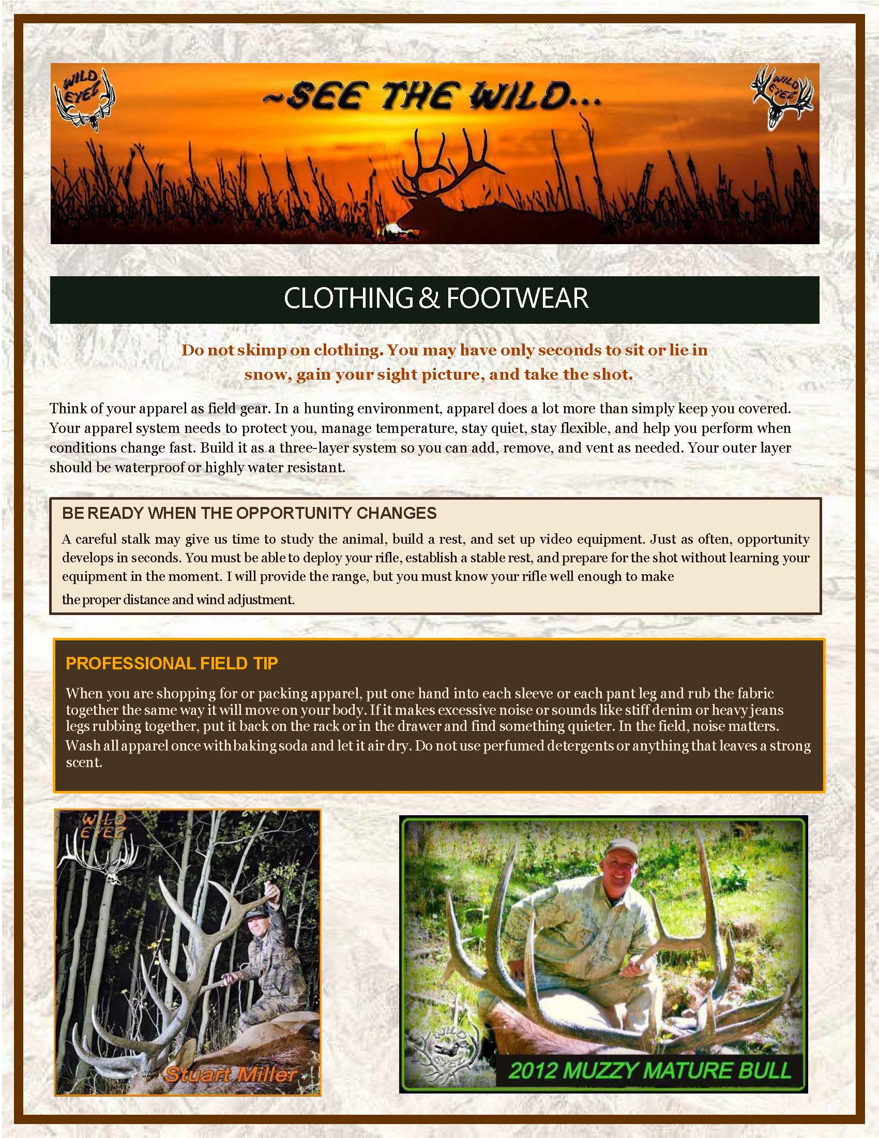
Page 4 - CLOTHING AND FOOTWEAR, OPPORTUNITY, AND PROFESSIONAL FIELD TIP Presenter direction: Show the Clothing and Footwear heading. Then move to the apparel system paragraphs. Hold on the Be Ready When the Opportunity Changes box, then move to the Professional Field Tip box. Spoken presentation: Page 4 begins the Clothing and Footwear section. Do not skimp on clothing. You may have only seconds to sit or lie in snow, gain your sight picture, and take the shot. Think of your apparel as field gear. In a hunting environment, apparel does a lot more than simply keep you covered. Your apparel system needs to protect you, manage temperature, stay quiet, stay flexible, and help you perform when conditions change fast. Build it as a three-layer system so you can add, remove, and vent as needed. Your outer layer should be waterproof or highly water resistant. Now highlight the Be Ready When the Opportunity Changes box. This box is important because it connects clothing, gear, rifle familiarity, and real hunting pressure. A careful stalk may give us time to study the animal, build a rest, and set up video equipment. Just as often, opportunity develops in seconds. You must be able to deploy your rifle, establish a stable rest, and prepare for the shot without learning your equipment in the moment. I will provide the range, but you must know your rifle well enough to make the proper distance and wind adjustment. Now highlight the Professional Field Tip box. This is one of those small field details that can prevent a real problem. When you are shopping for or packing apparel, put one hand into each sleeve or each pant leg and rub the fabric together the same way it will move on your body. If it makes excessive noise or sounds like stiff denim or heavy jeans legs rubbing together, put it back on the rack or in the drawer and find something quieter. In the field, noise matters. Wash all apparel once with baking soda and let it air dry. Do not use perfumed detergents or anything that leaves a strong scent.
Notes:
PAGE 4 - CLOTHING AND FOOTWEAR, OPPORTUNITY, AND PROFESSIONAL FIELD TIP Presenter direction: Show the Clothing and Footwear heading. Then move to the apparel system paragraphs. Hold on the Be Ready When the Opportunity Changes box, then move to the Professional Field Tip box. Spoken presentation: Page 4 begins the Clothing and Footwear section. Do not skimp on clothing. You may have only seconds to sit or lie in snow, gain your sight picture, and take the shot. Think of your apparel as field gear. In a hunting environment, apparel does a lot more than simply keep you covered. Your apparel system needs to protect you, manage temperature, stay quiet, stay flexible, and help you perform when conditions change fast. Build it as a three-layer system so you can add, remove, and vent as needed. Your outer layer should be waterproof or highly water resistant. Now highlight the Be Ready When the Opportunity Changes box. This box is important because it connects clothing, gear, rifle familiarity, and real hunting pressure. A careful stalk may give us time to study the animal, build a rest, and set up video equipment. Just as often, opportunity develops in seconds. You must be able to deploy your rifle, establish a stable rest, and prepare for the shot without learning your equipment in the moment. I will provide the range, but you must know your rifle well enough to make the proper distance and wind adjustment. Now highlight the Professional Field Tip box. This is one of those small field details that can prevent a real problem. When you are shopping for or packing apparel, put one hand into each sleeve or each pant leg and rub the fabric together the same way it will move on your body. If it makes excessive noise or sounds like stiff denim or heavy jeans legs rubbing together, put it back on the rack or in the drawer and find something quieter. In the field, noise matters. Wash all apparel once with baking soda and let it air dry. Do not use perfumed detergents or anything that leaves a strong scent.
[Sources]
Wild Eyez Outfitters current packet page image and Adobe presentation script.

Slide 5
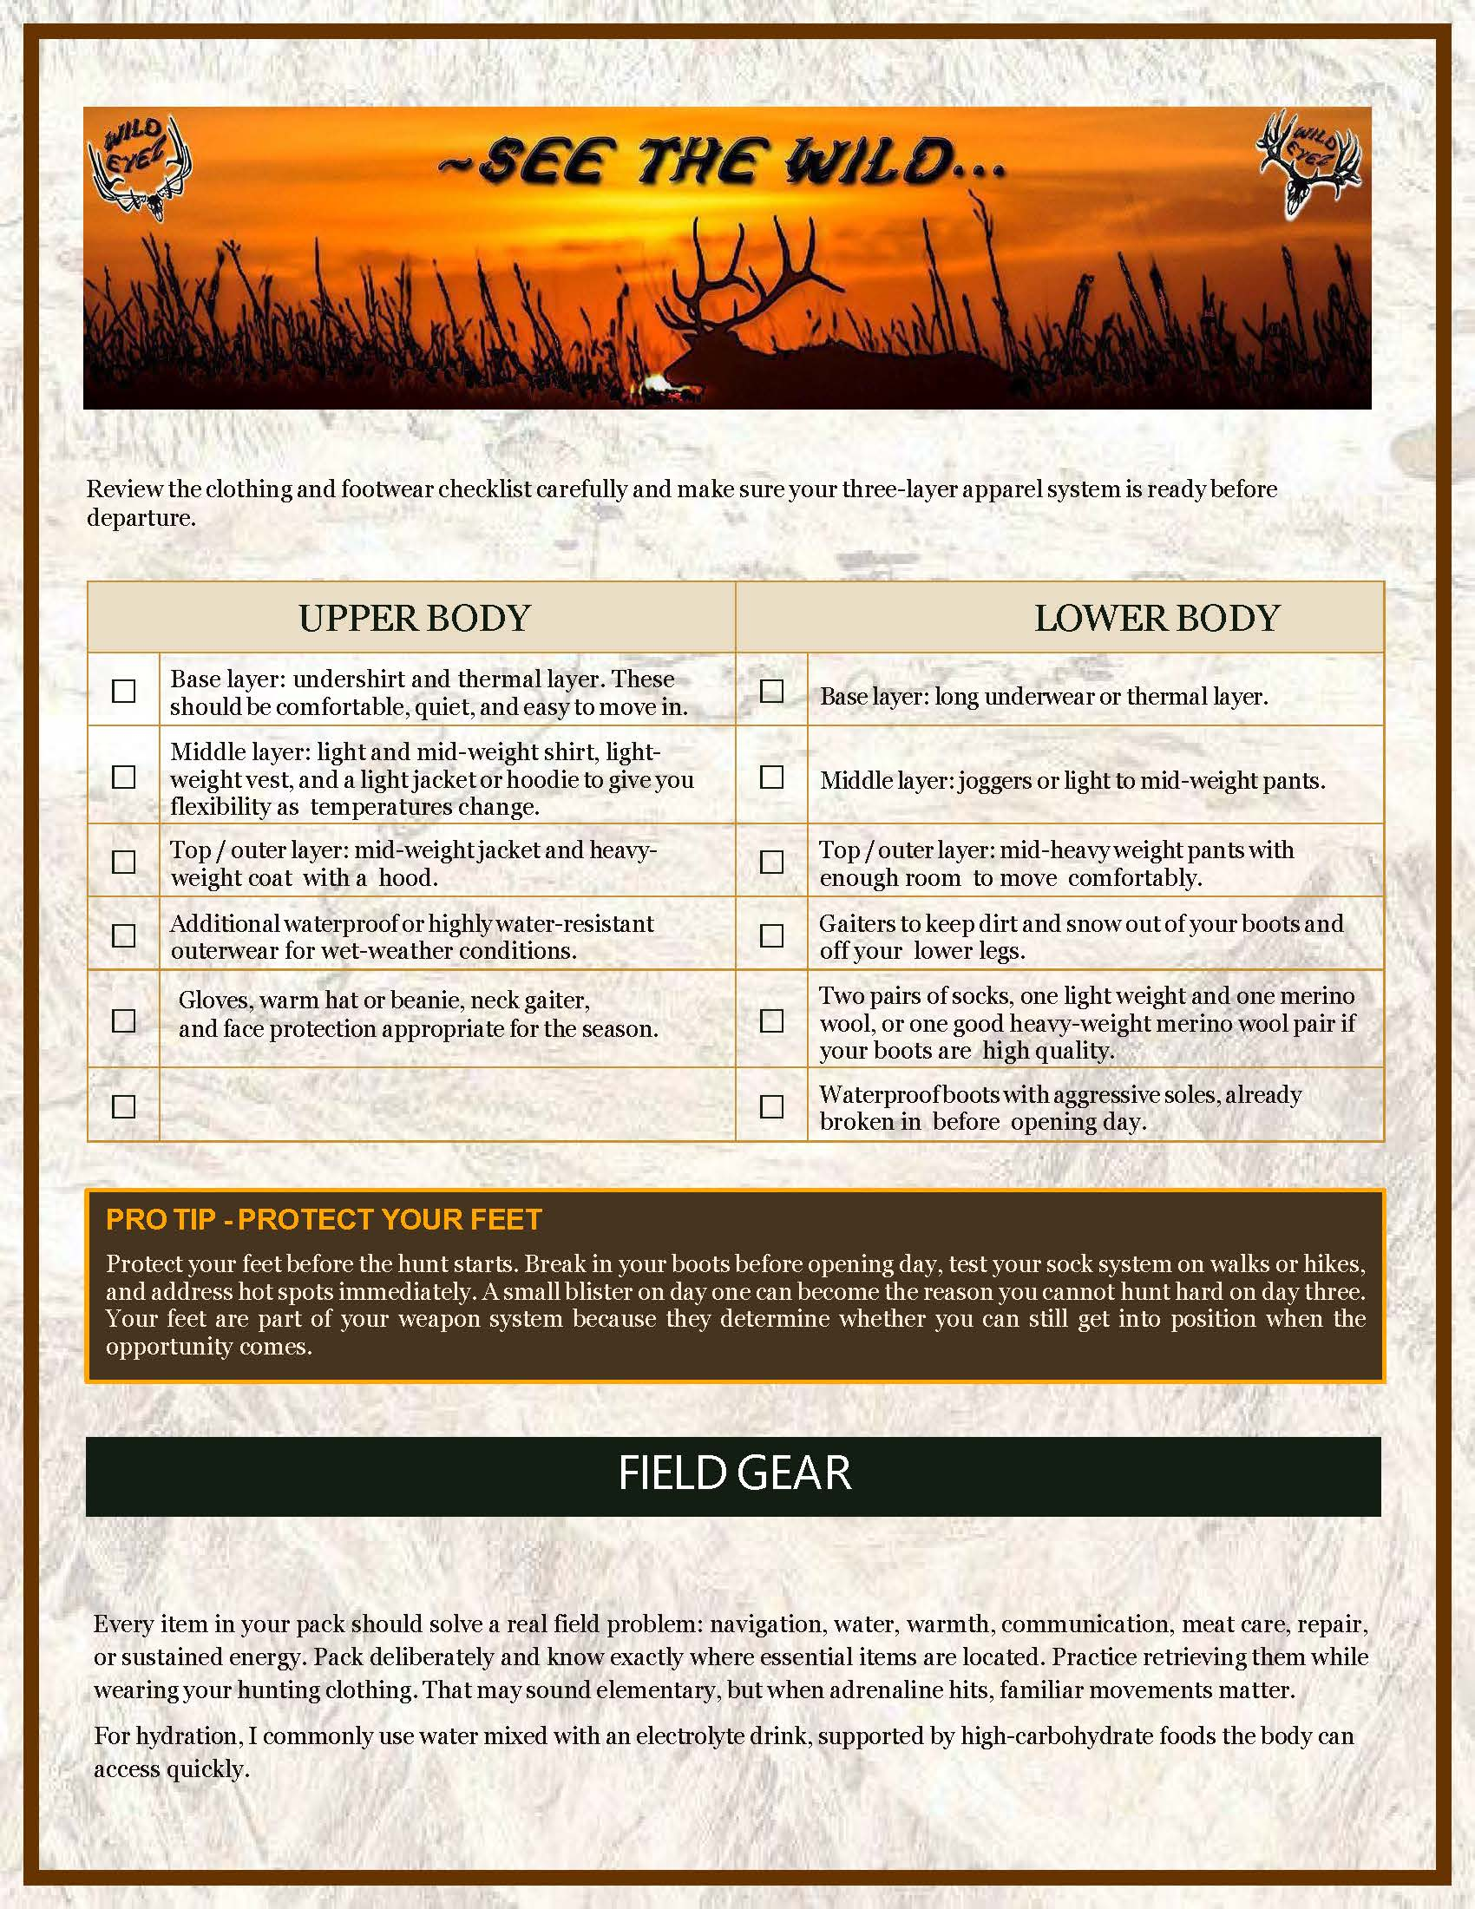
Page 5 - CLOTHING CHECKLIST, FOOT CARE, AND FIELD GEAR Presenter direction: Show the clothing checklist as a practical working table. Do not dramatize every line. Then hold on the foot-care tip box. After that, move into Field Gear. Spoken presentation: Page 5 continues the clothing and footwear system. Review the clothing and footwear checklist carefully and make sure your three-layer apparel system is ready before departure. This checklist should confirm that your base layers, mid layers, outer layers, socks, boots, gaiters, and wet-weather protection work together as a complete field system. Now highlight the Field Tip - Protect Your Feet box. This box deserves attention because feet can make or break the hunt. Start before the hunt. Break in your boots before opening day, test your sock system on walks or hikes, and address hot spots immediately. A small blister on day one can become the reason you cannot hunt hard on day three. Your feet are part of your weapon system because they determine whether you can still get into position when the opportunity comes. Now move into Field Gear. Every item in your pack should solve a real field problem: navigation, water, warmth, communication, meat care, repair, or sustained energy. Pack deliberately and know exactly where essential items are located. Practice retrieving them while wearing your hunting clothing. That may sound elementary, but when adrenaline hits, familiar movements matter. For hydration, I commonly use water mixed with an electrolyte drink, supported by high-carbohydrate foods the body can access quickly.
Notes:
PAGE 5 - CLOTHING CHECKLIST, FOOT CARE, AND FIELD GEAR Presenter direction: Show the clothing checklist as a practical working table. Do not dramatize every line. Then hold on the foot-care tip box. After that, move into Field Gear. Spoken presentation: Page 5 continues the clothing and footwear system. Review the clothing and footwear checklist carefully and make sure your three-layer apparel system is ready before departure. This checklist should confirm that your base layers, mid layers, outer layers, socks, boots, gaiters, and wet-weather protection work together as a complete field system. Now highlight the Field Tip - Protect Your Feet box. This box deserves attention because feet can make or break the hunt. Start before the hunt. Break in your boots before opening day, test your sock system on walks or hikes, and address hot spots immediately. A small blister on day one can become the reason you cannot hunt hard on day three. Your feet are part of your weapon system because they determine whether you can still get into position when the opportunity comes. Now move into Field Gear. Every item in your pack should solve a real field problem: navigation, water, warmth, communication, meat care, repair, or sustained energy. Pack deliberately and know exactly where essential items are located. Practice retrieving them while wearing your hunting clothing. That may sound elementary, but when adrenaline hits, familiar movements matter. For hydration, I commonly use water mixed with an electrolyte drink, supported by high-carbohydrate foods the body can access quickly.
[Sources]
Wild Eyez Outfitters current packet page image and Adobe presentation script.

Slide 6
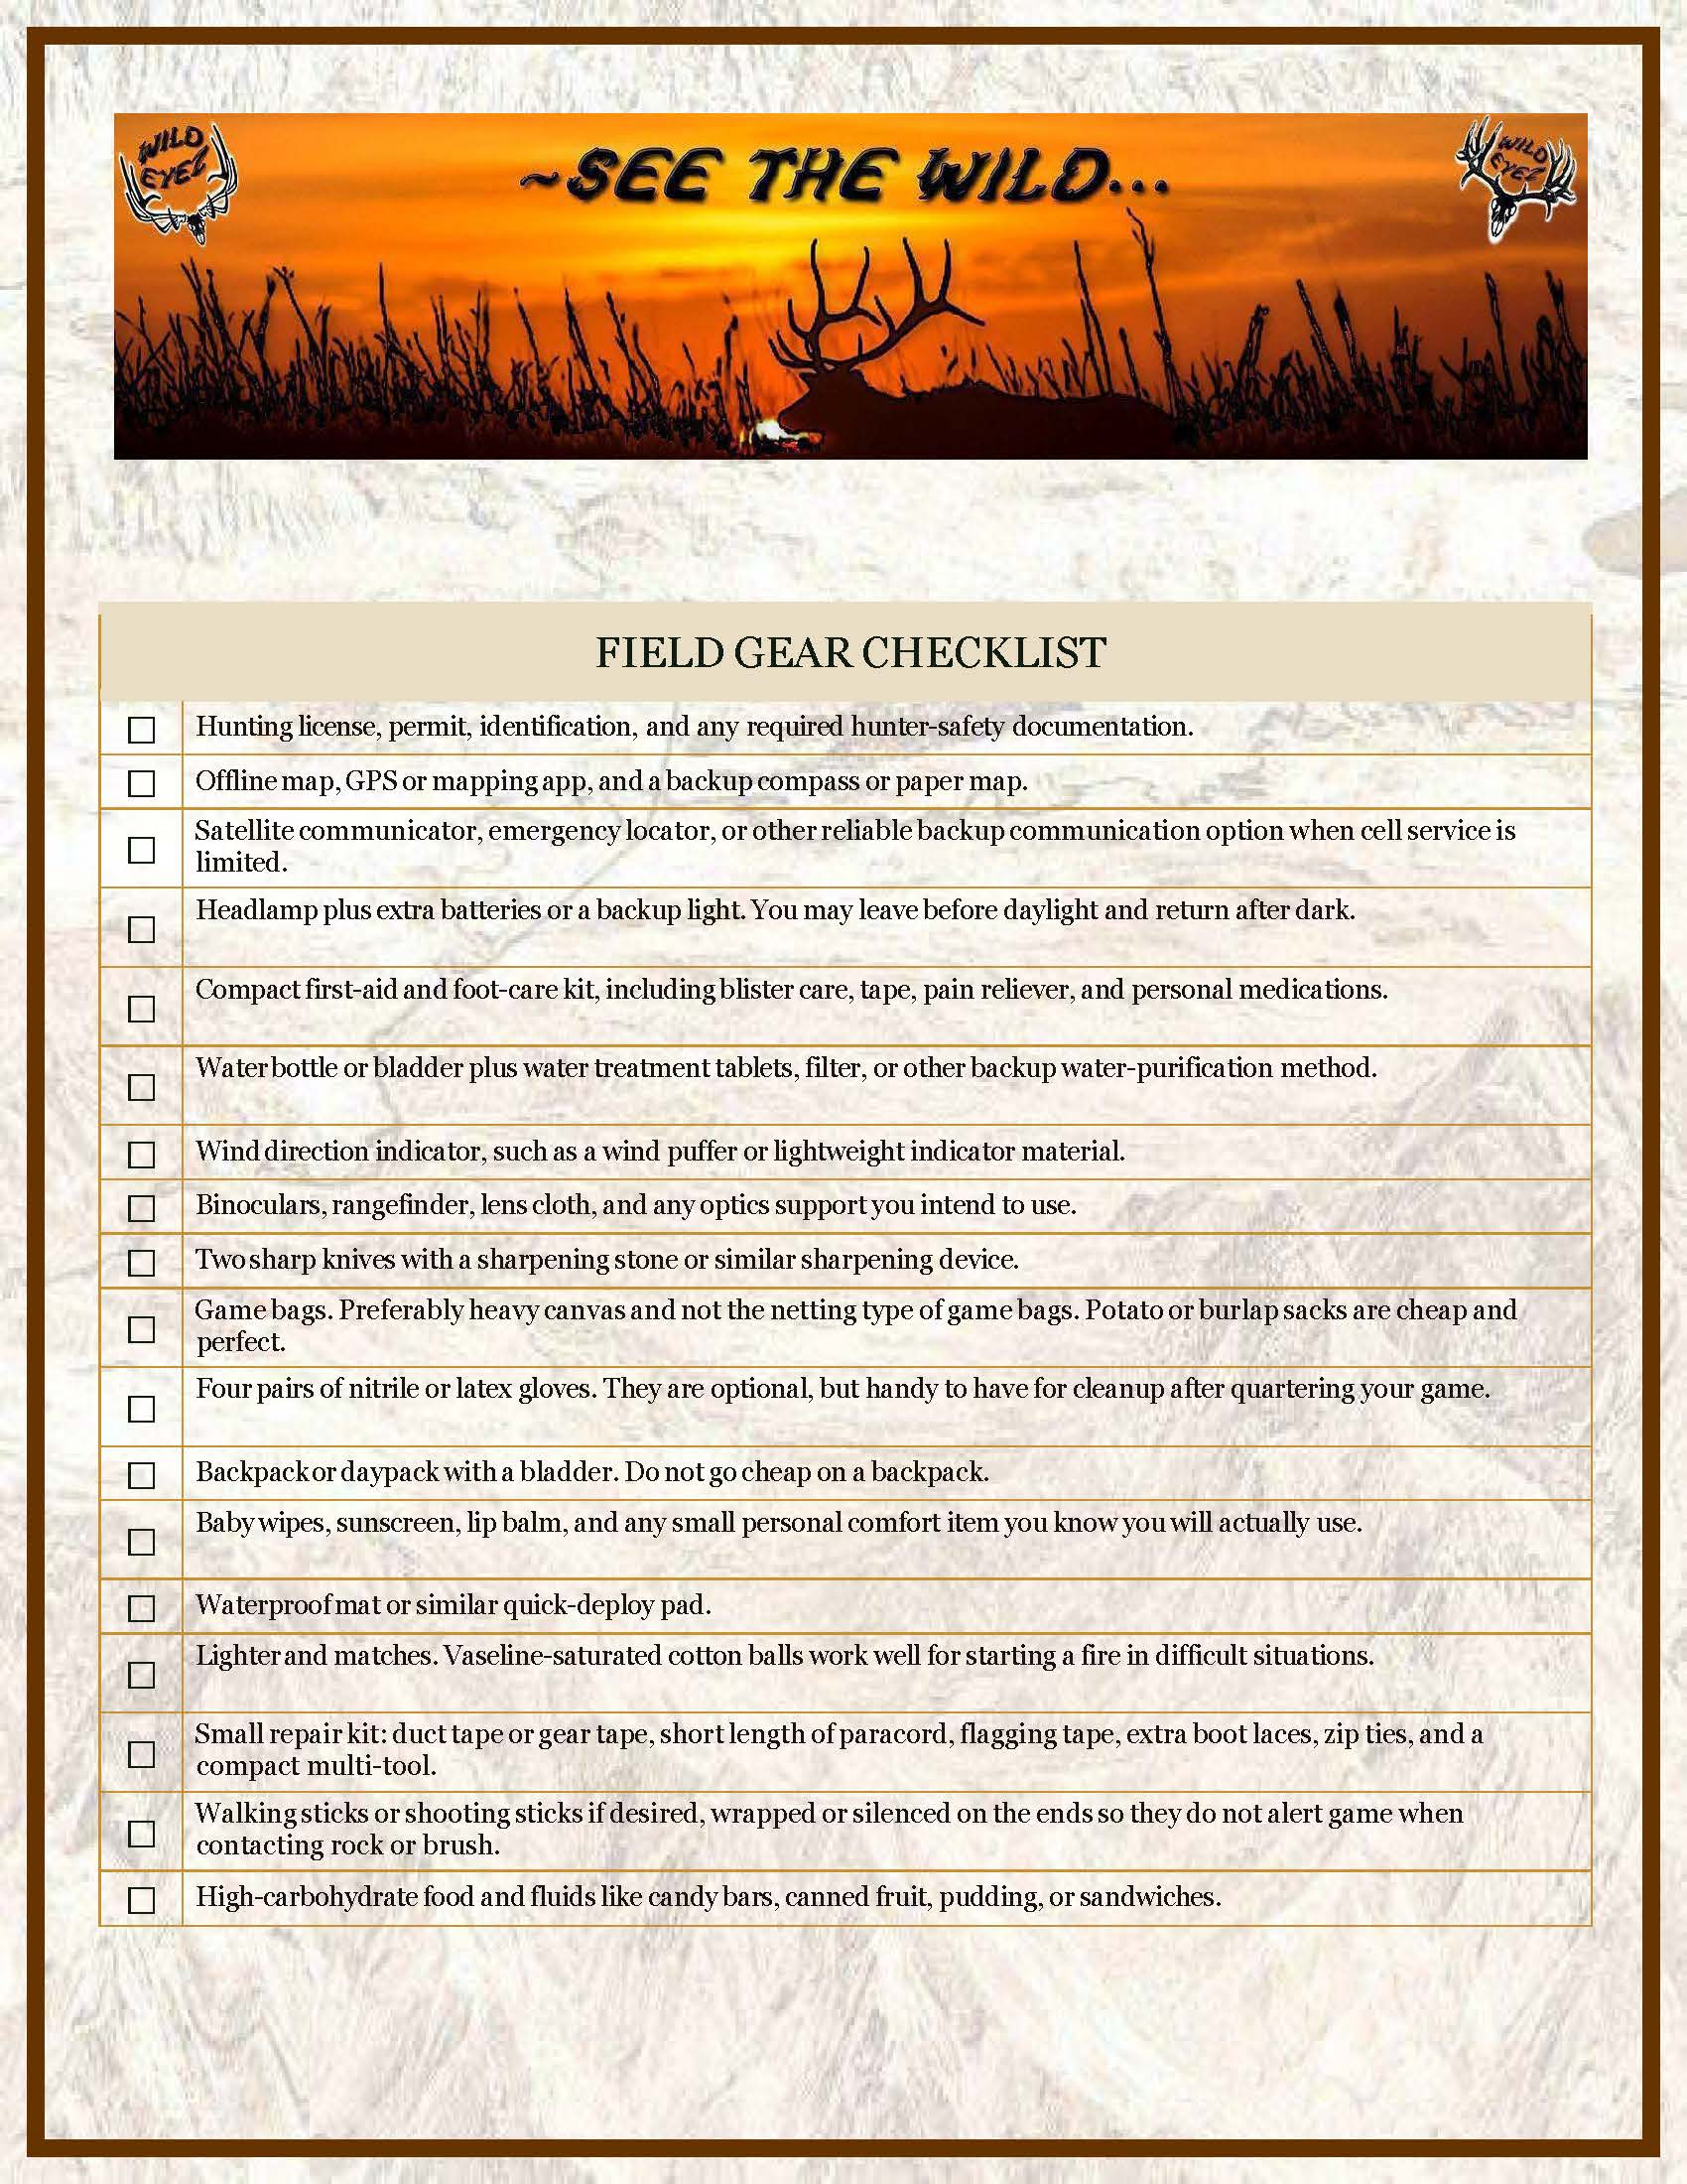
Page 6 - FIELD GEAR CHECKLIST Presenter direction: Show the checklist as a full checklist page or checklist area. Use a slow vertical pan. The checklist should feel useful, not rushed. Spoken presentation: Page 6 is the Field Gear Checklist. Use this checklist as a visual reference. Review the items carefully and confirm that your pack solves the real field problems listed here: navigation, water, warmth, communication, meat care, repair, and sustained energy. You do not need to memorize the list while listening. Use it as a practical packing check before departure. This page should be treated as a working tool. A hunter can come back to it while packing, while checking the truck, and again before leaving home.
Notes:
PAGE 6 - FIELD GEAR CHECKLIST Presenter direction: Show the checklist as a full checklist page or checklist area. Use a slow vertical pan. The checklist should feel useful, not rushed. Spoken presentation: Page 6 is the Field Gear Checklist. Use this checklist as a visual reference. Review the items carefully and confirm that your pack solves the real field problems listed here: navigation, water, warmth, communication, meat care, repair, and sustained energy. You do not need to memorize the list while listening. Use it as a practical packing check before departure. This page should be treated as a working tool. A hunter can come back to it while packing, while checking the truck, and again before leaving home.
[Sources]
Wild Eyez Outfitters current packet page image and Adobe presentation script.

Slide 7
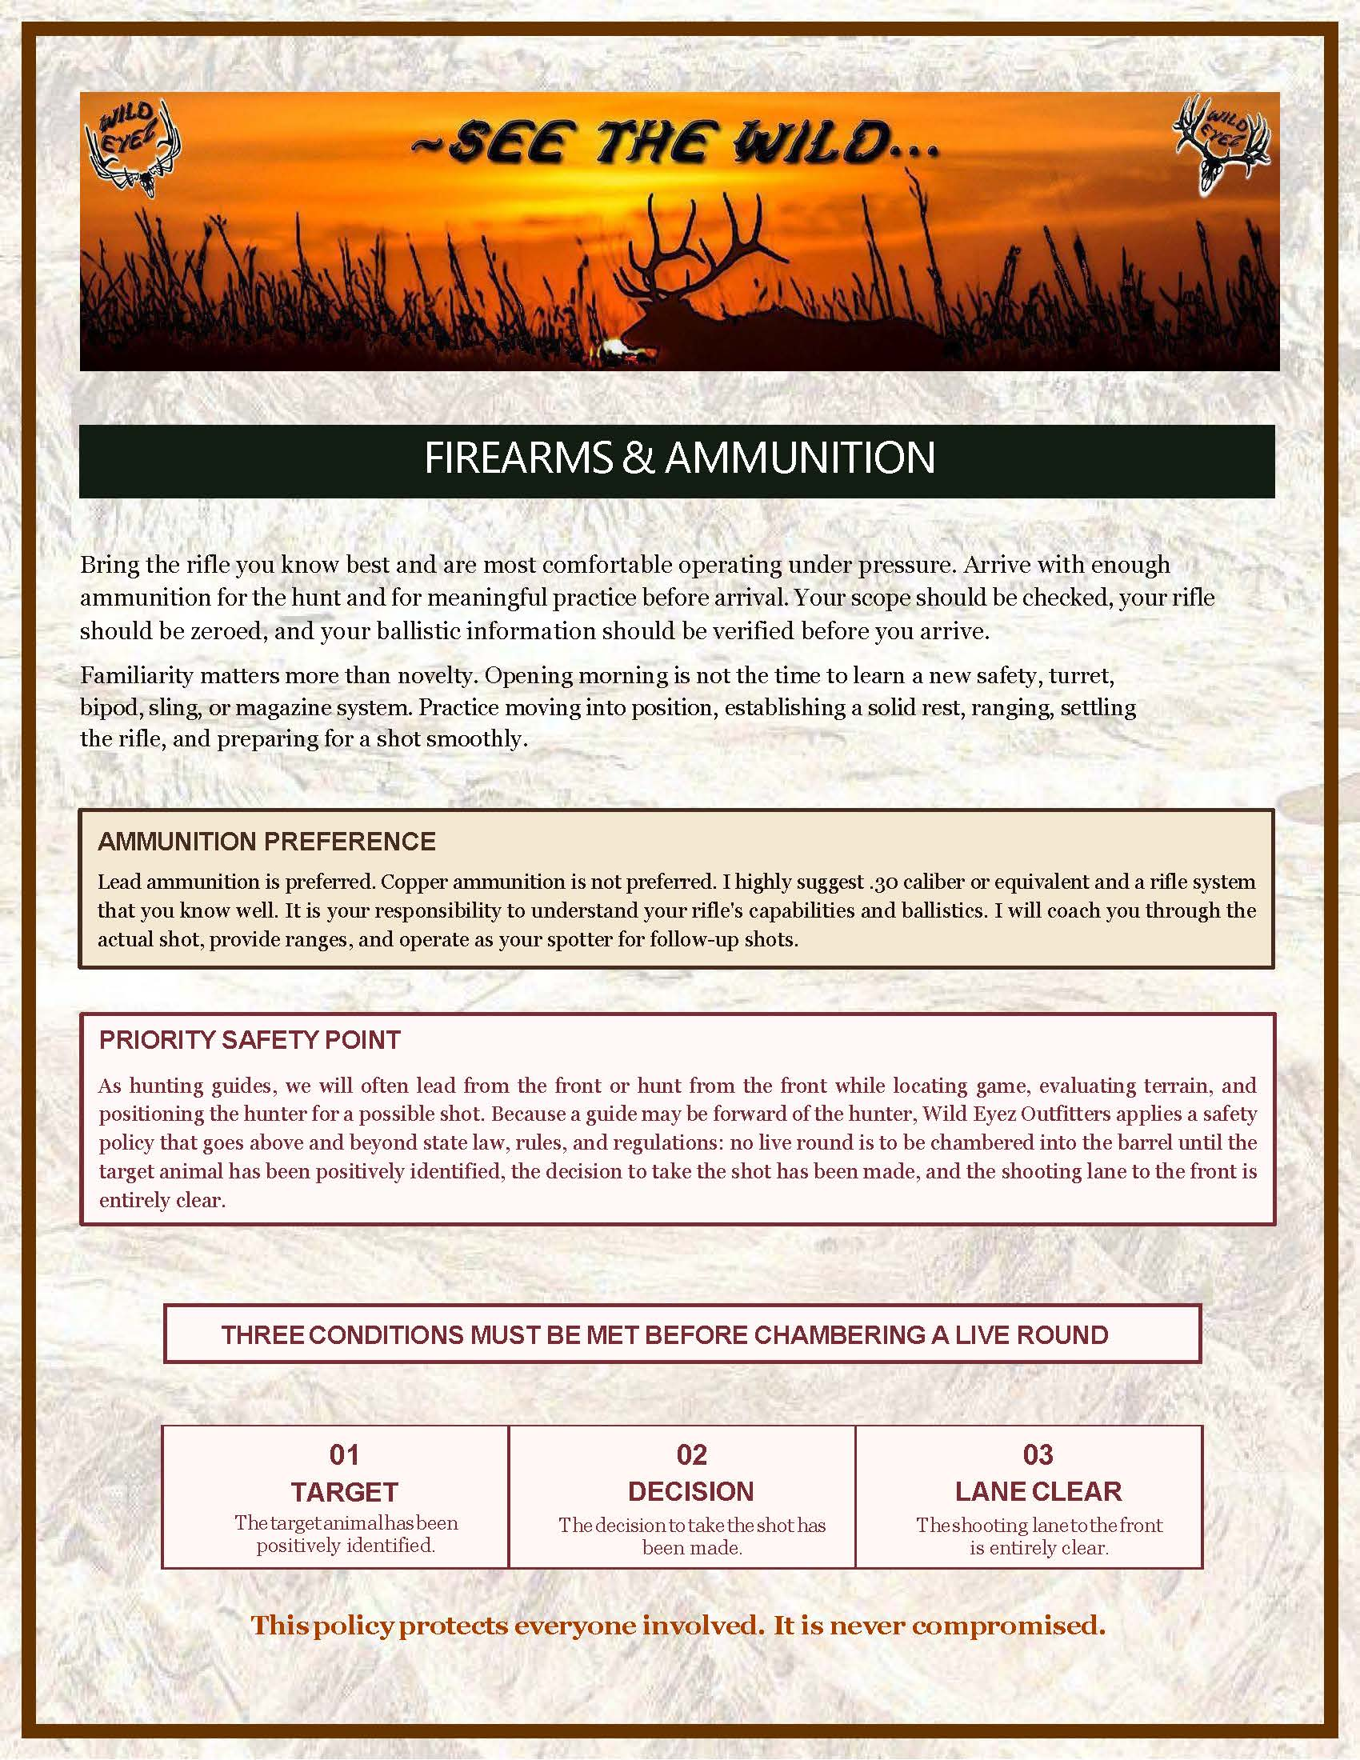
Page 7 - FIREARMS, AMMUNITION, AND SAFETY Presenter direction: Start with the Firearms and Ammunition heading. Move through the firearm preparation text. Then give special attention to the Ammunition Preference box, the Priority Safety Point box, and the Three Conditions safety block. Spoken presentation: Page 7 covers Firearms and Ammunition. Bring the rifle you know best and are most comfortable operating under pressure. Arrive with enough ammunition for the hunt and for meaningful practice before arrival. Your scope should be checked, your rifle should be zeroed, and your ballistic information should be verified before you arrive. Familiarity matters more than novelty. Opening morning is not the time to learn a new safety, turret, bipod, sling, or magazine system. Practice moving into position, establishing a solid rest, ranging, settling the rifle, and preparing for a shot smoothly. Now highlight the Ammunition Preference box. This box should be treated as a strong outfitter recommendation. Led ammunition is preferred. Copper ammunition is not preferred. I highly suggest thirty caliber or equivalent and a rifle system that you know well. It is your responsibility to understand your rifle's capabilities and ballistics. I will coach you through the actual shot, provide ranges, and operate as your spotter for follow-up shots. Now highlight the Priority Safety Point box. This is one of the most important safety boxes in the entire packet. As hunting guides, we will often go first or hunt from the front while locating game, evaluating terrain, and positioning the hunter for a possible shot. Because a guide may be forward of the hunter, Wild Eyez Outfitters applies a safety policy that goes above and beyond state law, rules, and regulations: no live round is to be chambered into the barrel until the target animal has been positively identified, the decision to take the shot has been made, and the shooting lane to the front is entirely clear. Now move to the Three Conditions safety block. This block should be presented slowly and clearly. First: Target. The target animal has been positively identified. Second: Decision. The decision to take the shot has been made. Third: Lane clear. The shooting lane to the front is entirely clear. This policy protects everyone involved. It is never compromised.
Notes:
PAGE 7 - FIREARMS, AMMUNITION, AND SAFETY Presenter direction: Start with the Firearms and Ammunition heading. Move through the firearm preparation text. Then give special attention to the Ammunition Preference box, the Priority Safety Point box, and the Three Conditions safety block. Spoken presentation: Page 7 covers Firearms and Ammunition. Bring the rifle you know best and are most comfortable operating under pressure. Arrive with enough ammunition for the hunt and for meaningful practice before arrival. Your scope should be checked, your rifle should be zeroed, and your ballistic information should be verified before you arrive. Familiarity matters more than novelty. Opening morning is not the time to learn a new safety, turret, bipod, sling, or magazine system. Practice moving into position, establishing a solid rest, ranging, settling the rifle, and preparing for a shot smoothly. Now highlight the Ammunition Preference box. This box should be treated as a strong outfitter recommendation. Led ammunition is preferred. Copper ammunition is not preferred. I highly suggest thirty caliber or equivalent and a rifle system that you know well. It is your responsibility to understand your rifle's capabilities and ballistics. I will coach you through the actual shot, provide ranges, and operate as your spotter for follow-up shots. Now highlight the Priority Safety Point box. This is one of the most important safety boxes in the entire packet. As hunting guides, we will often go first or hunt from the front while locating game, evaluating terrain, and positioning the hunter for a possible shot. Because a guide may be forward of the hunter, Wild Eyez Outfitters applies a safety policy that goes above and beyond state law, rules, and regulations: no live round is to be chambered into the barrel until the target animal has been positively identified, the decision to take the shot has been made, and the shooting lane to the front is entirely clear. Now move to the Three Conditions safety block. This block should be presented slowly and clearly. First: Target. The target animal has been positively identified. Second: Decision. The decision to take the shot has been made. Third: Lane clear. The shooting lane to the front is entirely clear. This policy protects everyone involved. It is never compromised.
[Sources]
Wild Eyez Outfitters current packet page image and Adobe presentation script.

Slide 8
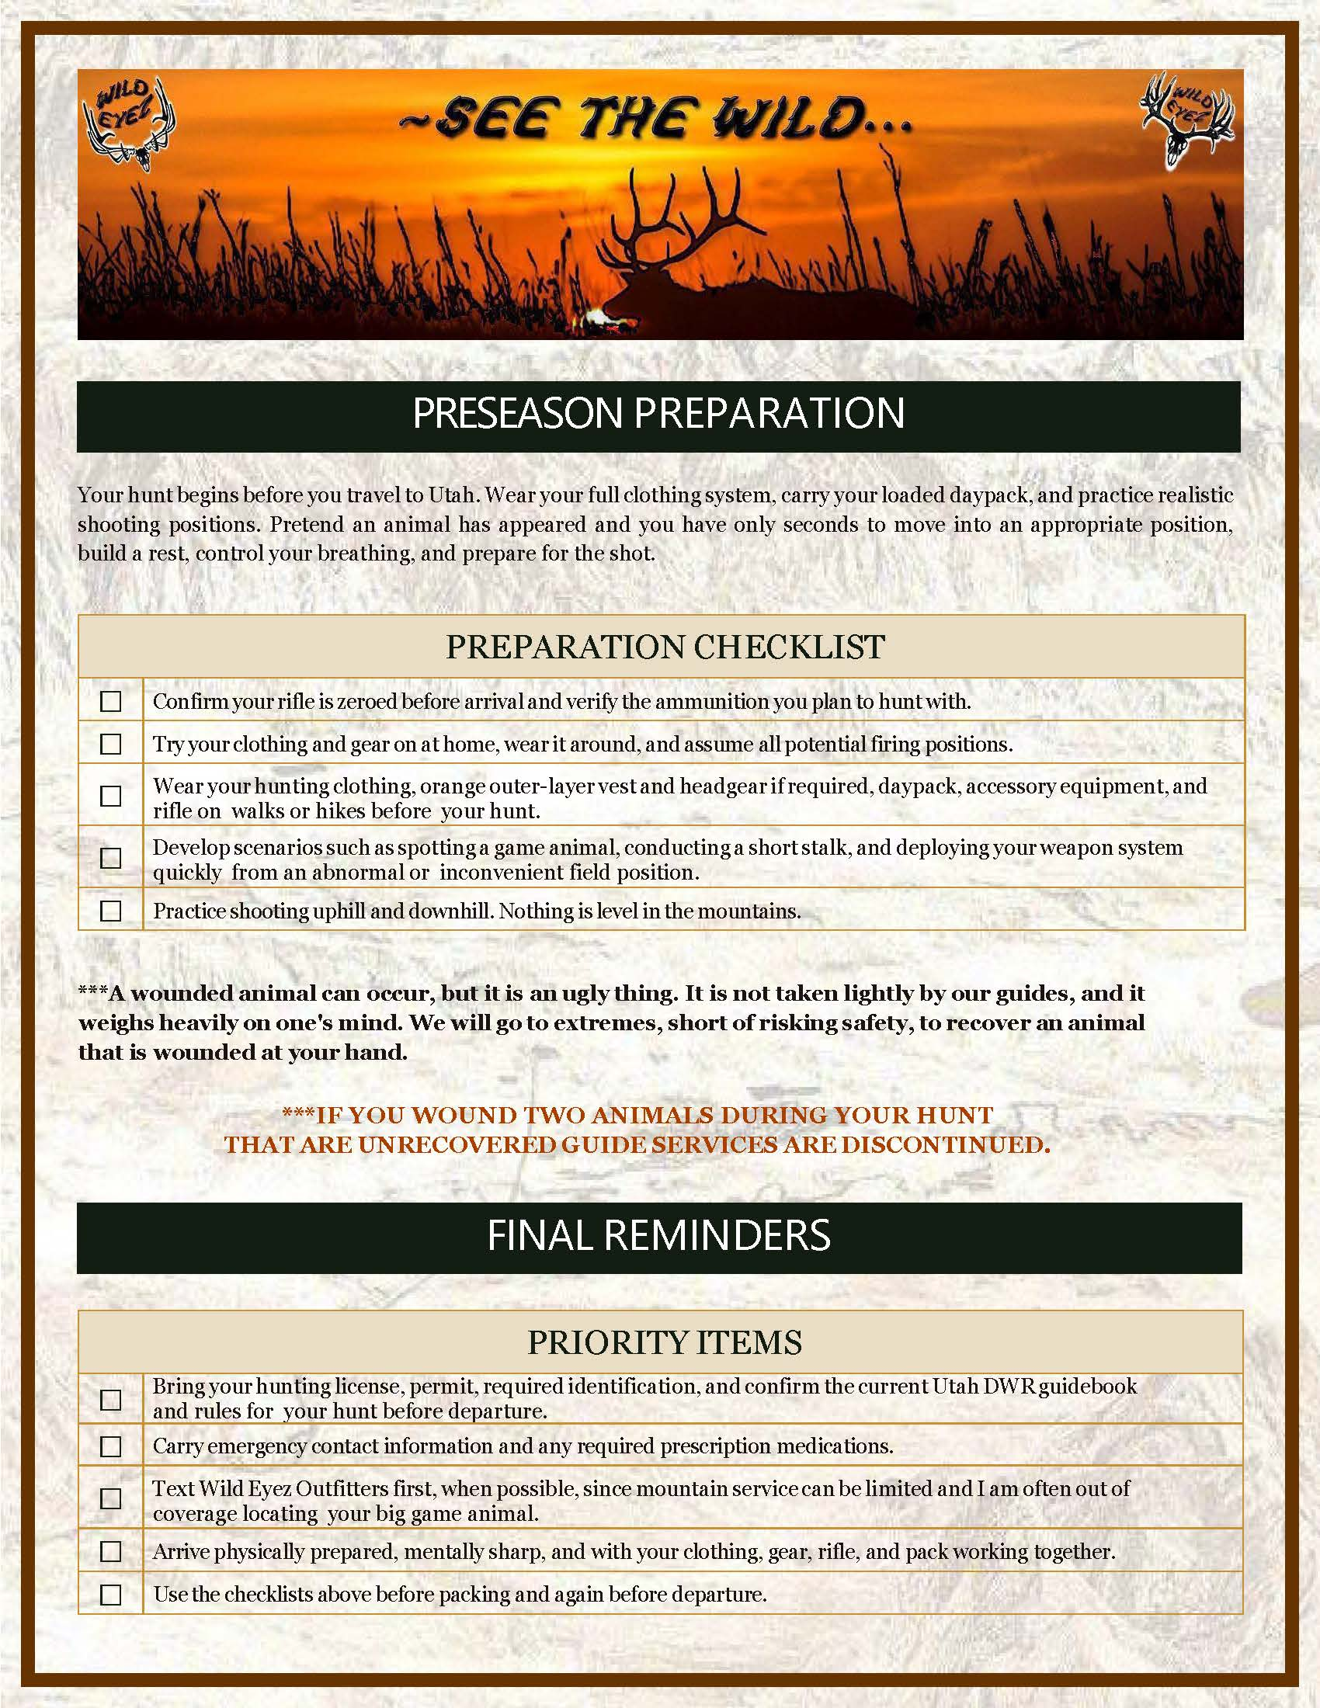
Page 8 - PRESEASON PREPARATION AND FINAL REMINDERS Presenter direction: Show the Preseason Preparation heading first. Then move into the Preparation Checklist as a practical action area. Hold briefly on the wounded animal policy because it is serious. Then move into Final Reminders. Spoken presentation: Page 8 covers Preseason Preparation. Your hunt begins before you travel to Utah. Wear your full clothing system, carry your loaded daypack, and practice realistic shooting positions. Pretend an animal has appeared and you have only seconds to move into an appropriate position, build a rest, control your breathing, and prepare for the shot. Now show the Preparation Checklist. Use the preparation checklist to confirm that your rifle, ammunition, clothing, gear, and shooting positions have all been tested before arrival. Do not save these checks for the mountain. Find the problems at home while there is still time to correct them. Now hold on the wounded animal policy. A wounded animal can occur, but it is an ugly thing. It is not taken lightly by our guides, and it weighs heavily on one's mind. We will go to extremes, short of risking safety, to recover an animal that is wounded at your hand. If you wound two animals during your hunt that are unrecovered, guide services are discontinued. Now move into Final Reminders. Review the final priority items carefully. Bring your hunting license, permit, required identification, and confirm the current Utah D.W.R. guidebook and rules for your hunt before departure. Carry emergency contact information and any required prescription medications. Text Wild Eyez Outfitters first when possible, since mountain service can be limited and I am often out of coverage locating your big game animal. Arrive physically prepared, mentally sharp, and with your clothing, gear, rifle, and pack working together. Use the checklists above before packing and again before departure.
Notes:
PAGE 8 - PRESEASON PREPARATION AND FINAL REMINDERS Presenter direction: Show the Preseason Preparation heading first. Then move into the Preparation Checklist as a practical action area. Hold briefly on the wounded animal policy because it is serious. Then move into Final Reminders. Spoken presentation: Page 8 covers Preseason Preparation. Your hunt begins before you travel to Utah. Wear your full clothing system, carry your loaded daypack, and practice realistic shooting positions. Pretend an animal has appeared and you have only seconds to move into an appropriate position, build a rest, control your breathing, and prepare for the shot. Now show the Preparation Checklist. Use the preparation checklist to confirm that your rifle, ammunition, clothing, gear, and shooting positions have all been tested before arrival. Do not save these checks for the mountain. Find the problems at home while there is still time to correct them. Now hold on the wounded animal policy. A wounded animal can occur, but it is an ugly thing. It is not taken lightly by our guides, and it weighs heavily on one's mind. We will go to extremes, short of risking safety, to recover an animal that is wounded at your hand. If you wound two animals during your hunt that are unrecovered, guide services are discontinued. Now move into Final Reminders. Review the final priority items carefully. Bring your hunting license, permit, required identification, and confirm the current Utah D.W.R. guidebook and rules for your hunt before departure. Carry emergency contact information and any required prescription medications. Text Wild Eyez Outfitters first when possible, since mountain service can be limited and I am often out of coverage locating your big game animal. Arrive physically prepared, mentally sharp, and with your clothing, gear, rifle, and pack working together. Use the checklists above before packing and again before departure.
[Sources]
Wild Eyez Outfitters current packet page image and Adobe presentation script.

Slide 9
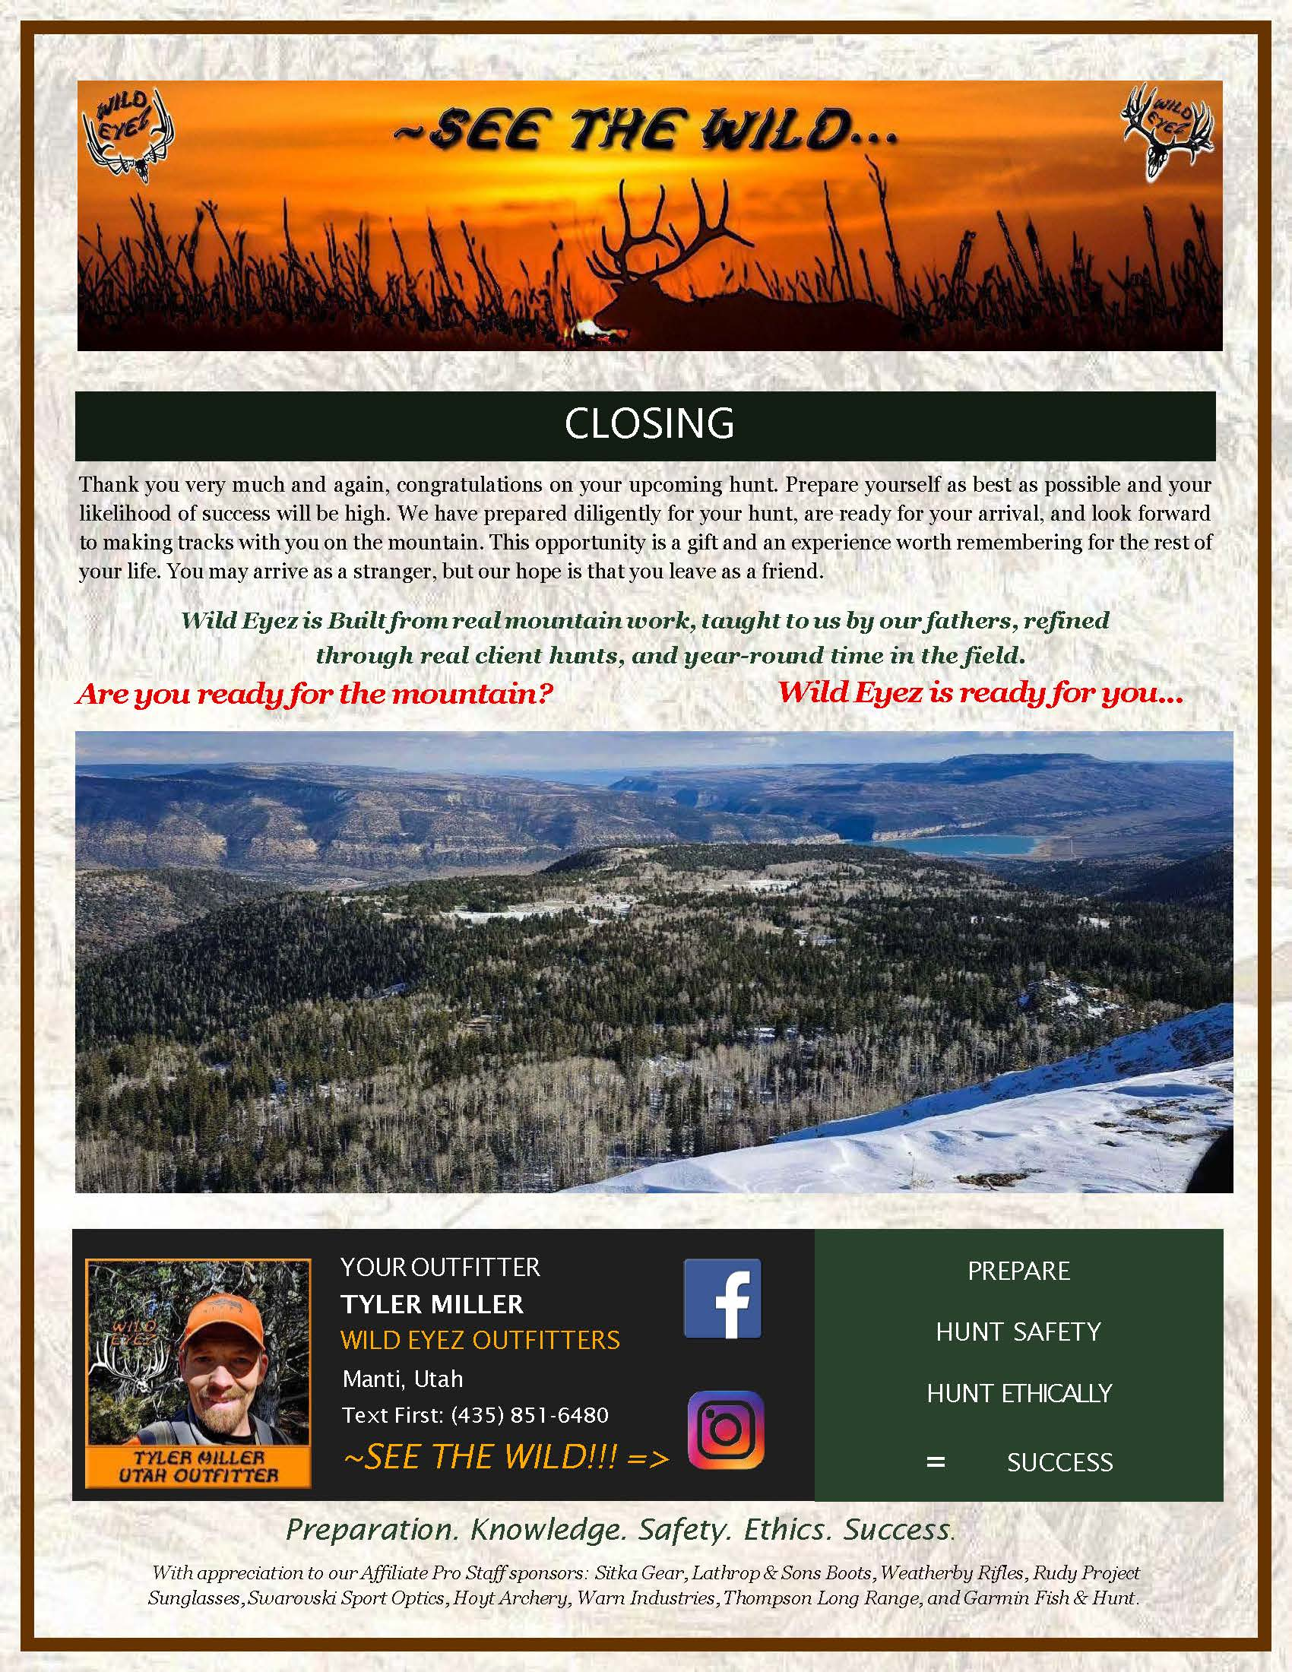
Page 9 - CLOSING Presenter direction: Slow the pace down on the closing page. Make this feel like a personal close from the outfitter. Keep the final slogan prominent and give it room. Spoken presentation: Page 9 closes the packet. Thank you very much and again, congratulations on your upcoming hunt. Prepare yourself as best as possible and your likelihood of success will be high. We have prepared diligently for your hunt, are ready for your arrival, and look forward to making tracks with you on the mountain. This opportunity is a gift and an experience worth remembering for the rest of your life. You may arrive as a stranger, but our hope is that you leave as a friend. Wild Eyez is built from real mountain work, taught to us by our fathers, refined through real client hunts, and year-round time in the field. Are you ready for the mountain? Wild Eyez is ready for you. SEE THE WILD!!! FINAL ADOBE NOTE This presentation should not feel like a slideshow made from a checklist. It should feel like an outfitter personally walking a client through the packet before the hunt. The checklists are working tools. The normal paragraphs explain what to expect. The highlight boxes are where the packet turns into hard-earned guide insight. Give those boxes extra visual weight, extra time on screen, and a serious, confident tone.
Notes:
PAGE 9 - CLOSING Presenter direction: Slow the pace down on the closing page. Make this feel like a personal close from the outfitter. Keep the final slogan prominent and give it room. Spoken presentation: Page 9 closes the packet. Thank you very much and again, congratulations on your upcoming hunt. Prepare yourself as best as possible and your likelihood of success will be high. We have prepared diligently for your hunt, are ready for your arrival, and look forward to making tracks with you on the mountain. This opportunity is a gift and an experience worth remembering for the rest of your life. You may arrive as a stranger, but our hope is that you leave as a friend. Wild Eyez is built from real mountain work, taught to us by our fathers, refined through real client hunts, and year-round time in the field. Are you ready for the mountain? Wild Eyez is ready for you. SEE THE WILD!!! FINAL ADOBE NOTE This presentation should not feel like a slideshow made from a checklist. It should feel like an outfitter personally walking a client through the packet before the hunt. The checklists are working tools. The normal paragraphs explain what to expect. The highlight boxes are where the packet turns into hard-earned guide insight. Give those boxes extra visual weight, extra time on screen, and a serious, confident tone.
[Sources]
Wild Eyez Outfitters current packet page image and Adobe presentation script.

